Slide 1


Leverage the Power of ML & AR / VR In Your Web App
Hiren Dave
Senior Technical Lead, iBASEt India
India

Slide 2
Session Agenda
How to add Machine Learning in your web app
Practical usages of ML in eCommerce app
Adding AR / VR to your web app
Practical usages of AR / VR in eCommerce app

Slide 3
Machine Learning
In Web

Slide 4
Why Machine Learning with JavaScript?
No Drivers / No Installs
Highly Interactive
Access to Sensors
Can work offline
Web is Everywhere

Slide 5

TensorFlow.js
A Machine Learning library in JavaScript
Either Use it in browser or with Node.js
Run existing models
Retrain existing models
Create new Model in JavaScript

Slide 6
Use it with script tag
<script src="https://cdn.jsdelivr.net/npm/@tensorflow/tfjs@2.0.0/dist/tf.min.js"></script>

Slide 7
Install with yarn or npm cli
yarn add @tensorflow/tfjs
npm install @tensorflow/tfjs

Slide 8
Practical usages of ML in eCommerce app
Build a model that can recommend products
Image recognition and processing
Chatbot for customer service and support
Personalized content for end user
Predictions about the customers
Site search optimization
Fraud protection

Slide 9
Let’s see the Demos
TensorFlow.js

Slide 10
AR / VR
In Web

Slide 11
What is Augmented Reality?
AR means enhanced version of real world
Add virtual / digital content in real world
Enhance reality with interactive digital content
Digital content can be audio, graphics, 3D content or any other virtual enhancement

Slide 12
What is Virtual Reality?
VR means an artificial environment created by code
It simulates the real world environment
VR takes the user inside the experience
In simple words it’s totally artificial

Slide 13
What is WebXR?
It brings both AR and VR to Web.
Together it is referred as Mixed Reality or Cross Reality
WebXR Device API provides a way to access AR / VR devices
Using it you can add AR / VR experiences to Web

Slide 14
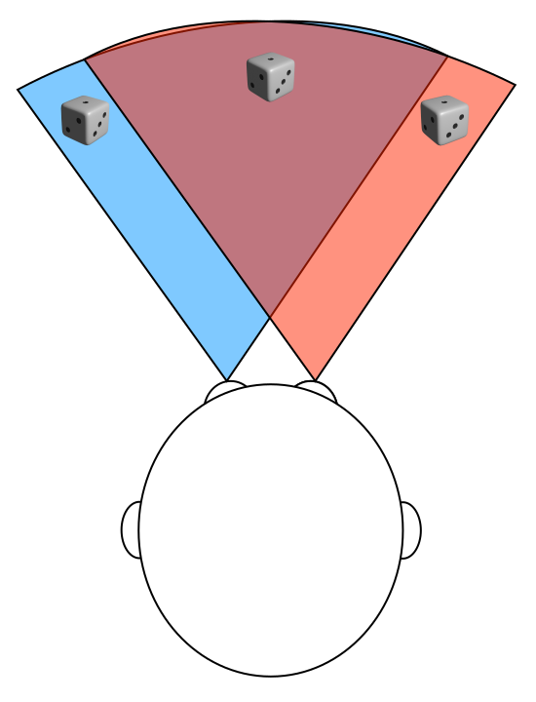
WebXR - Field of View
It defines extent to which user is able to see the environment
Human eye can take in a FOV of around 135 degrees
Two eyes FOV overlap each other, hence total FOV is around 200 to 220 degrees

Slide 15
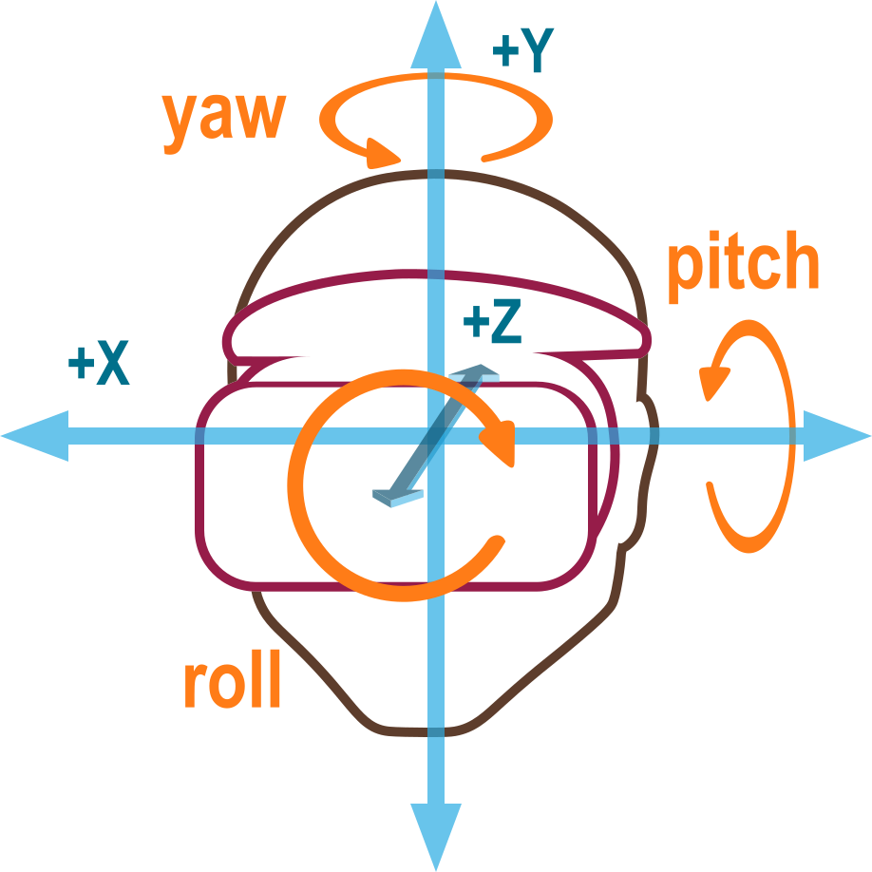
WebXR - Degrees of Freedom
It defines the freedom of movement in virtual world
It defines rotational movement & translation movements

Slide 16
WebXR Application Lifecycle
First check if browser or device supports XR
Check if WebXR API is available - navigator.xr
Check if type of session is available - navigator.xr.isSessionSupported
Add interface to launch the session
Start the session - XRSession
End the Session - XRSession.end

Slide 17
WebXR Device API
Initialization
Session
Frame loop
Session
Layers
Views
Pose
Anchors

Slide 18
Frameworks
Three.js
A-Frame
Babylon.js

Slide 19
Practical usages of AR / VR in eCommerce app
Create In store experience with Virtual store
Create interactive user manual
Create Virtual Try On experiences

Slide 20
Let’s see the Demos
WebXR

Slide 21
References
https://www.tensorflow.org/js
https://js.tensorflow.org/api/latest/
https://www.tensorflow.org/js/tutorials
https://developers.google.com/ar/develop/webxr
https://www.w3.org/TR/webxr/
https://developer.mozilla.org/en-US/docs/Web/API/WebXR_Device_API

